Slide 1

Data Structures & Algorithms
Mohammad Nayeem Teli

Slide 2

About this Course
An introduction to algorithms and data structures.
What are algorithms?
Design of algorithms.
Data structures for algorithms
Evaluation of algorithms.

Slide 3

About this course
Course webpage is on Moodle,
http://moodle.harrisburgu.edu. Please check it on daily
basis.
All our course information is on that website including
the assignments.

Slide 4

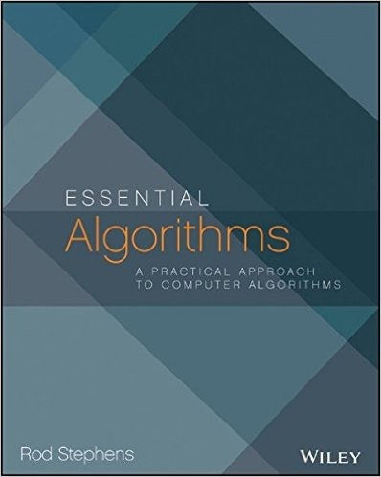
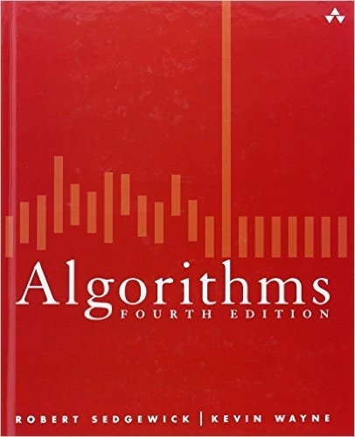
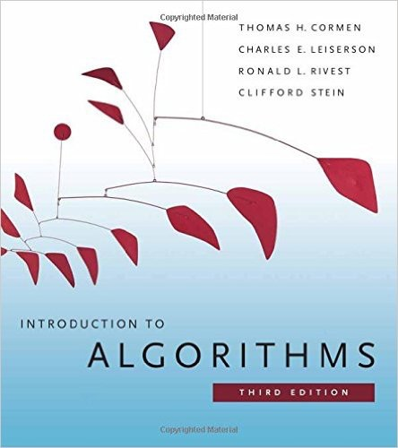
Texts
“Essential Algorithms: A Practical Approach to Computer Algorithms”, Rod Stephens, Ist Ed., 2013.
“Algorithms”, 4th Ed., by Robert Sedgewick and Kevin Wayne Addison-Wesley, 2011.
“Introduction to Algorithms”, by Thomas H. Cormen et al. 3rd Ed. MIT Press, 2009

Slide 5

About this course
Lectures
You pay for them, might as well use them
We are here to help

Slide 6

Components of the course
Participation / Quizzes:
“are you with us?” not worth many points but useful finger on the pulse (for you and me)
Tests :
“what have you learned?” Important checkpoints!!
Programming assignments :
“can you implement it?”

Slide 7

Grading
Assignments 4 x 10 = 40
Midterm 25
Final 25
Class Participation 10

Slide 8
Other Logistics
Online via Adobe Connect every thursday 7:00 - 8:00 PM

Slide 9

Professional class behavior
We all have to have respect for each other, independent of race, gender, ability, belief etc.
Pay attention
THERE ARE NO STUPID QUESTIONS
Your classmates will be grateful you asked.

Slide 10

Cheating
What is cheating? What is not?
Where would you find a definition?
Student HONOR code in student handbook.
What is gained / lost when cheating?
What are the consequences?
When / how does it happen?
How can cheating be avoided?

